Slide 1
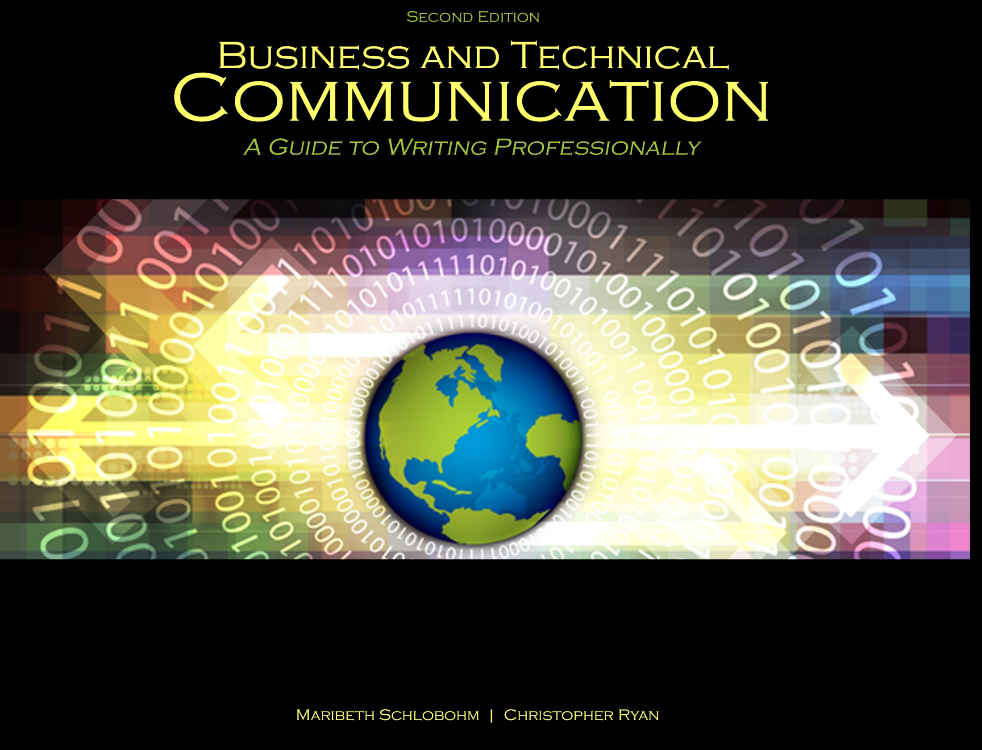
Chapter 2: Audience

Slide 2

Audience
PURPOSE:
Informing
Persuading
TYPES:
Decision makers
Influencers
Those who need to know (end users)

Slide 3

Audience
TYPES OF AUDIENCE:
Decision makers
Influencers
Those who need to know
(end users)

Slide 4
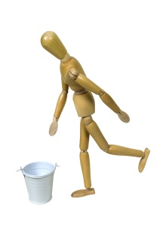
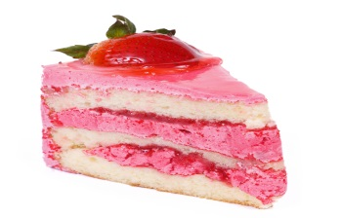
Communication Barriers
Idiom: Kick the bucket
Language
Culture and customs
- Humor, slang, idioms
- Word usage and spelling
Education and experience
Age, race, gender, and national
origin
Religion and politics
Idiom: Piece of cake

Slide 5
Communication Barriers
TO OVERCOME, CONSIDER:
Word usage and spelling
Gender neutrality
Avoiding contractions
Applying “you” only when truly addressing audience

Slide 6
References
Schlobohm, Maribeth and Christopher Ryan. Business and Technical Communication: A Guide to Writing Professionally, 2nd Ed., Dubuque, IA: Kendall-Hunt, 2014. Print.
Shutterstock. “Closeup hand open book for reading concept background,” Image ID: 130330691; “Kicking the bucket is a slang term meaning to die,” Image ID: 50303194; “Pink strawberry cake isolated on white background,” Image ID: 108862316. Feb 2014. Web.

Slide 7
Contact Information
Kendall-Hunt Publishing Company
4050 Westmark Drive
Dubuque, IA 52004-1840
http://www.kendallhunt.com
Toll Free: 800-228-0810

